Slide 1

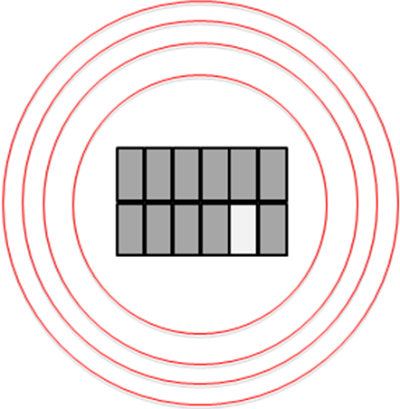
PTF-2 as trigger for UV mission
FOV increase: x4.5 – x6 with respect to PTF. Can maintain nightly cadence during dark time (and dark parts of grey nights) on current PTF footprint

Slide 2
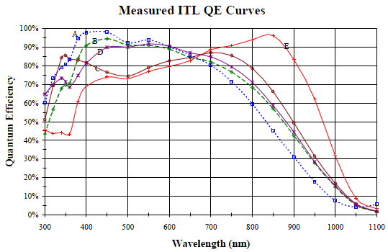
QEs
STA-ITL CCDs can offer very high (>70%) throughput in U while still decent all the way to R. Substantial improvement (unique capability).

Slide 3
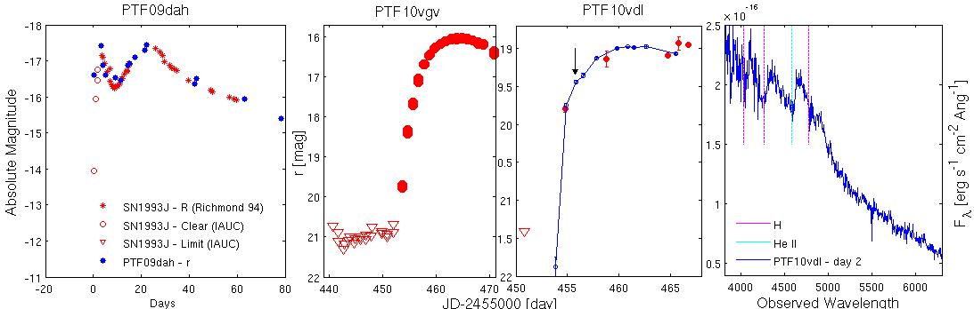
Detectability
PTF can detect SNe on day 1 and react. PTF-2 will be much better. Young SNe (at least) are easier to detect in U (x5 – x10 more flux).

Slide 4
Target numbers
We know the PTF core-collapse yearly SN number, which is ~150. Given larger area (but denser sampling) of PTF-2, the yearly number would be ~300, of which 50% during dark time (U-band survey), so 150 a year, again.
Given weather, about 50% should be discovered within a day of explosion, and ~10% within hours of explosion.

